Slide 1
PROJECT TITLE: secure data hiding in images using steganography
CAPSTONE PROJECT
Presented By:
Student Name : SHIAIKH FIROZ SHAIKH ISMAIL
College Name & Department : BABASAHEB NAIK COLLEGE OF ENGINEERING, PUSAD
(COMPUTER SCIENCE & ENGINEERING)

Slide 2
OUTLINE
Problem Statement
Technology used
Wow factor
End users
Result
Conclusion
Git-hub Link
Future scope

Slide 3
Problem Statement
In today's digital world, secure communication is crucial to prevent unauthorized access to sensitive information.
Traditional encryption methods can be detected, making them vulnerable to attacks.
This project focuses on Image Steganography, where a secret message is hidden within an image, ensuring secure data transmission without raising suspicion.

Slide 4
Technology used
Programming Language: Python
Libraries:
OpenCV (cv2) for image processing
OS module for handling file operations
Platform: Atleast 4GB RAM, Windows 10 (or above)
Steganography Method: Pixel-based encoding of text within an image.

Slide 5
Wow factors
Invisible Data Transmission: The encoded message is hidden within an image, making it undetectable to the naked eye.
Password Protection: The decryption process requires a passcode, adding an extra layer of security.
Simple Yet Effective: The method alters pixel values slightly, ensuring minimal changes to the image while embedding text.

Slide 6
End users
Cybersecurity Experts: For secure communication and covert messaging.
Journalists & Whistleblowers: To share sensitive information safely.
Military & Intelligence Agencies: For confidential communication.
Personal Users: Anyone wanting to send hidden messages without attracting attention.

Slide 7
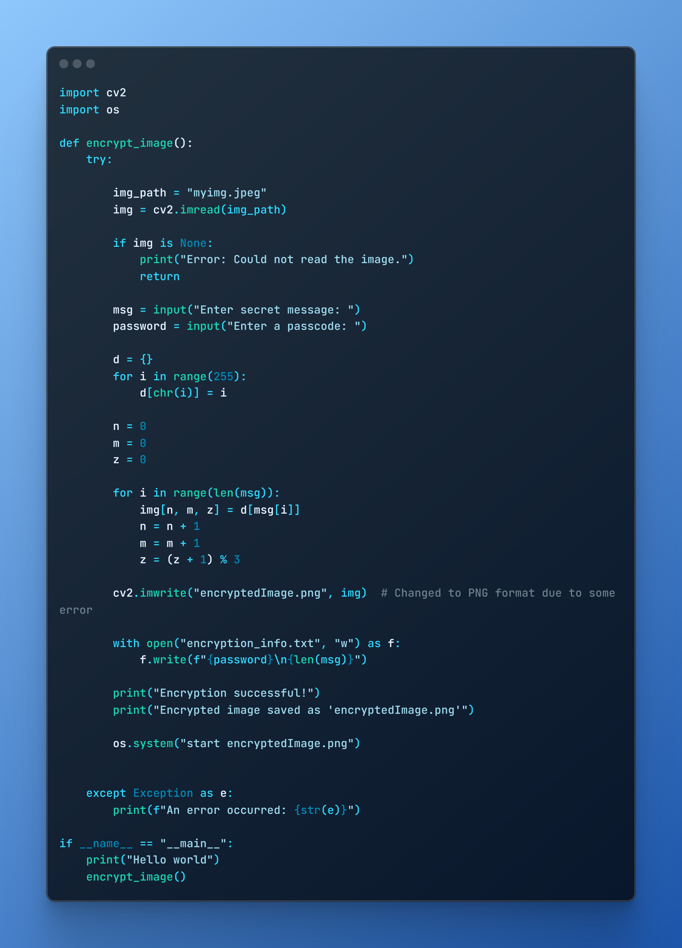
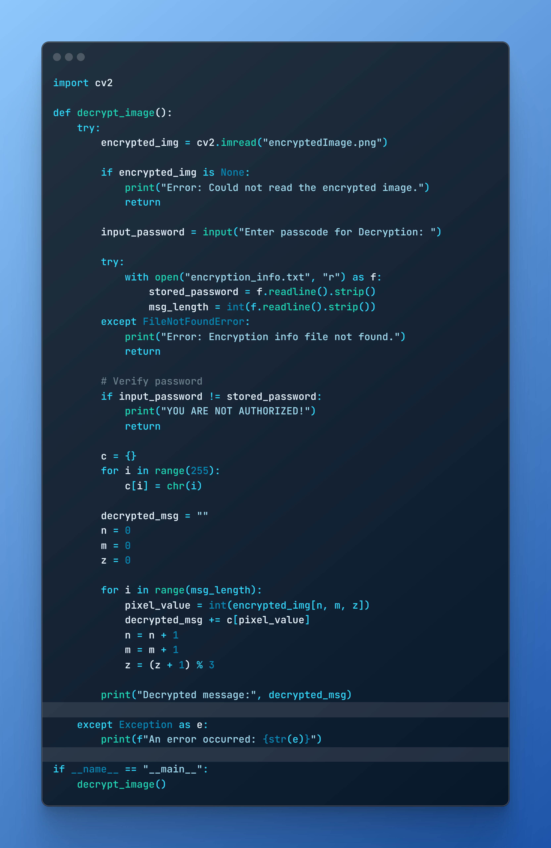
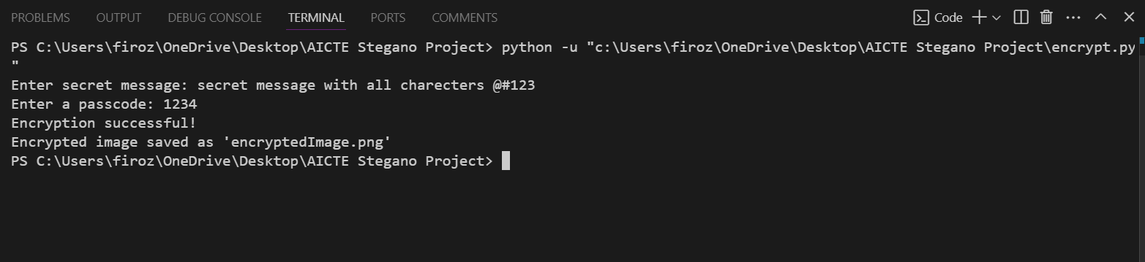
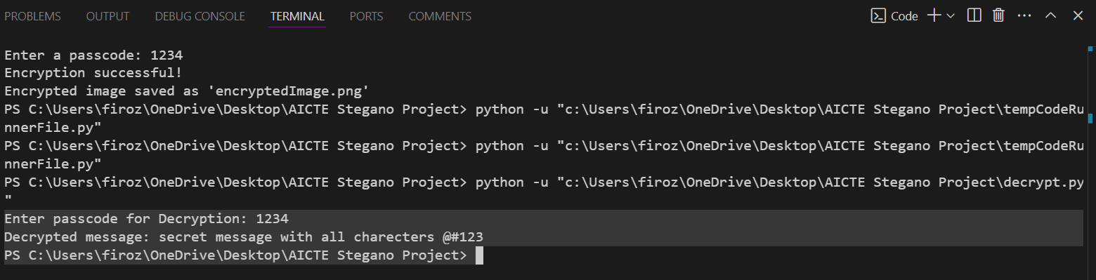
Results
Encryption Output
Decryption Output
Encryption Code
Decryption Code

Slide 8
Conclusion
This project demonstrates how steganography can be used to enhance data security.
By embedding messages within images, we ensure that sensitive information remains hidden from prying eyes.
The implementation is simple yet effective for personal and professional use.

Slide 9
GitHub Link
https://github.com/Firozsk13/AICTE-Steganography-project.git

Slide 10
Future scope(optional)
AI-based Detection Prevention: Implementing AI techniques to bypass steganalysis tools that detect hidden messages.
Enhanced Encryption: Combining steganography with cryptographic algorithms for higher security.
Multi-layer Encoding: Hiding messages within multiple image layers for better secrecy.

Slide 11
THANK YOU

